Slide 1


SCRUM
SCRUM Team: Geryl, Maria, Nafisat, Neha, Pri

Slide 2
AGENDA
What is Scrum
Terminology
Ceremonies
Scrum Visualization
Advantages and Disadvantages
Importance of Scrum in BI Project
Why use Scrum?

Slide 3
SCRUM
What is it?
A framework within which people can address complex adaptive problems, while productively and creatively delivering products of the highest possible value.
How it came to be:
Created in Japan in 1986 for the manufacturing sector.
Adapted to the Software industry in 1993 as an Agile methodology.

Slide 4
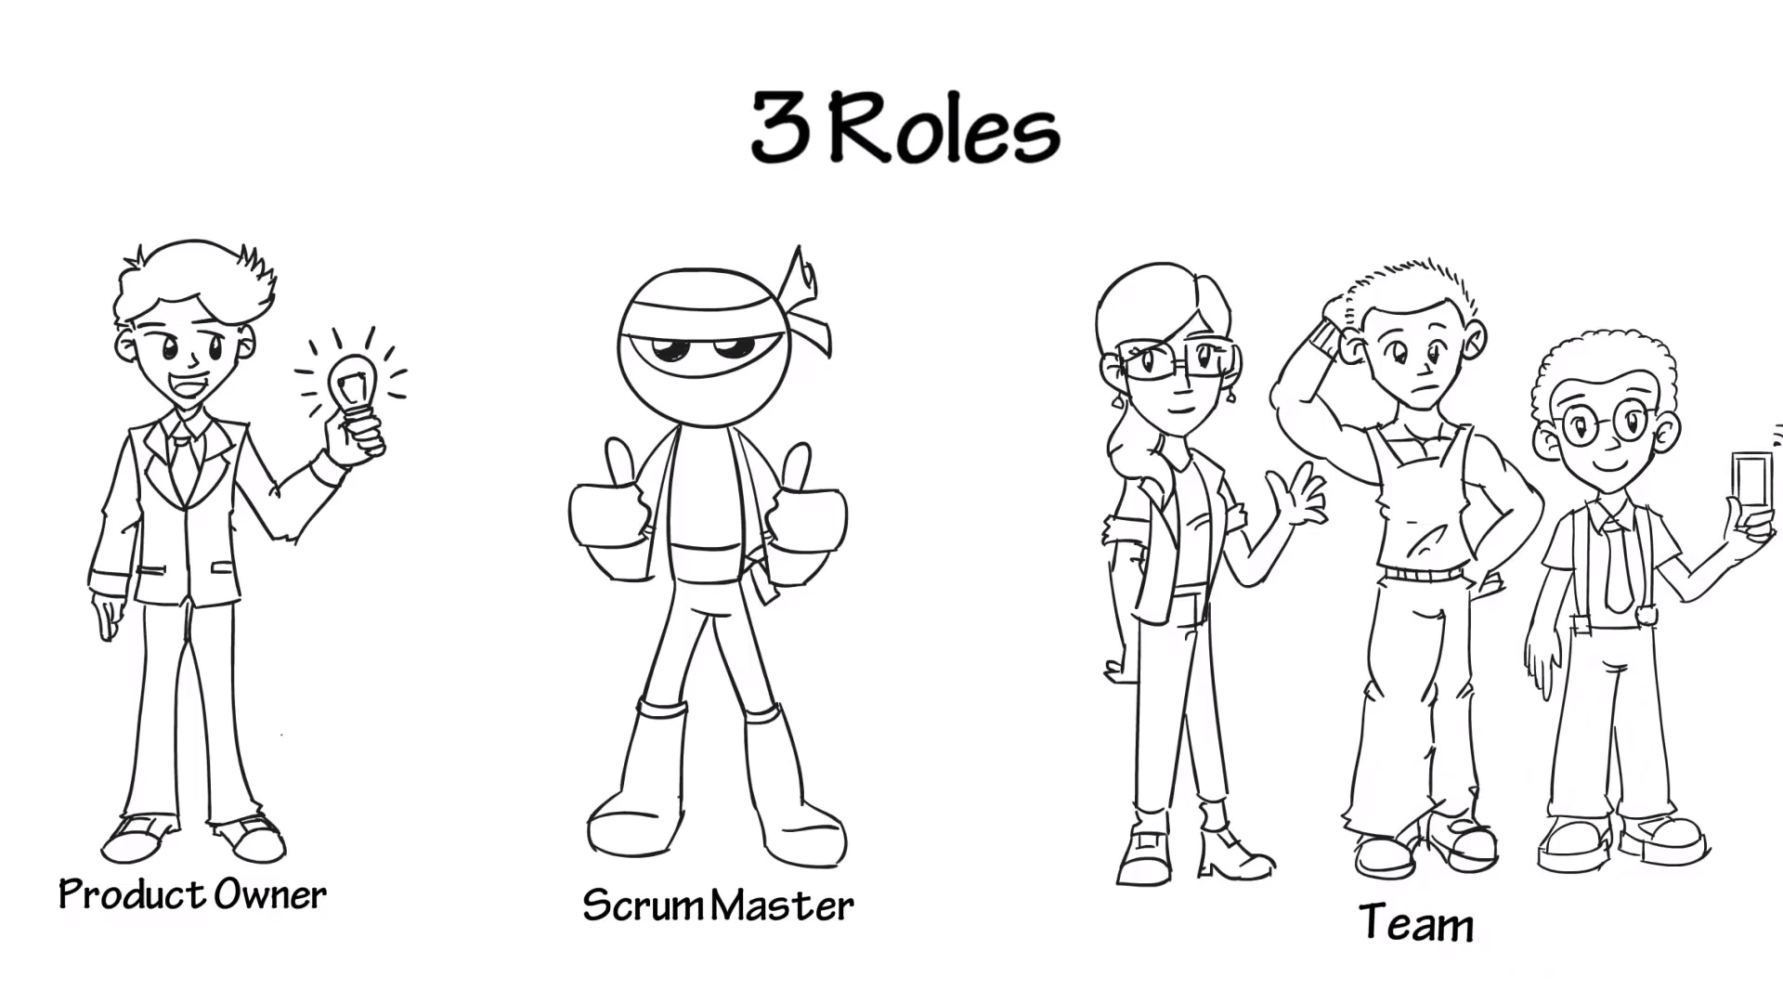
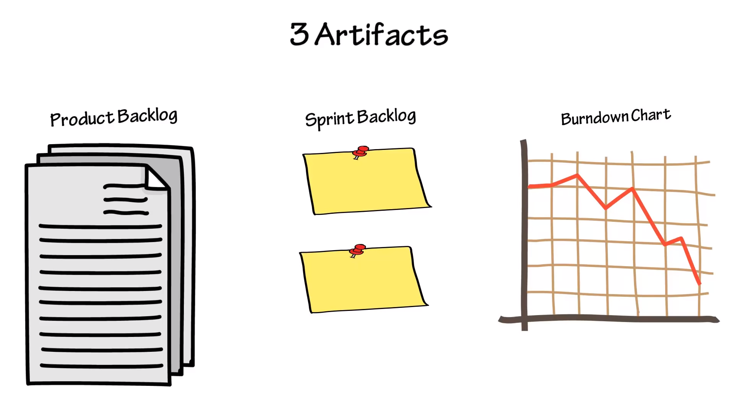
Scrum terminology:

Slide 5

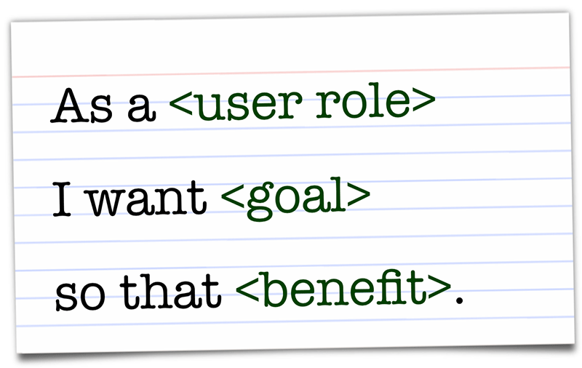

Slide 6
Scrum Meetings:
Sprint planning – Scrum Team
Sprint Reviews – PO and Stakeholders
Sprint Retrospective – Scrum Team
Daily Scrum – Scrum Team

Slide 7
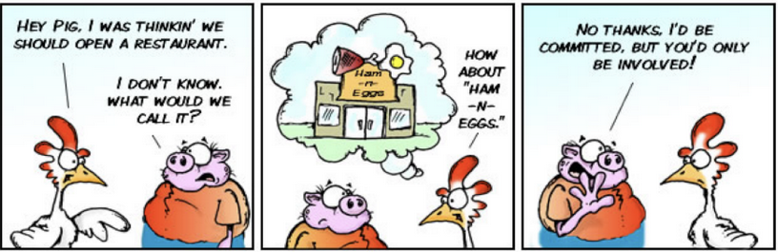
Stand Up Meeting (Daily Scrum):
Performed in the morning, standing up
No more than 15 minutes in duration
3 Questions are answered:
What did I complete yesterday?
What am I working on today?
What is blocking me from completing my work?
Only Pigs can talk. A chickens can only talk if a pig addresses him/her:

Slide 8
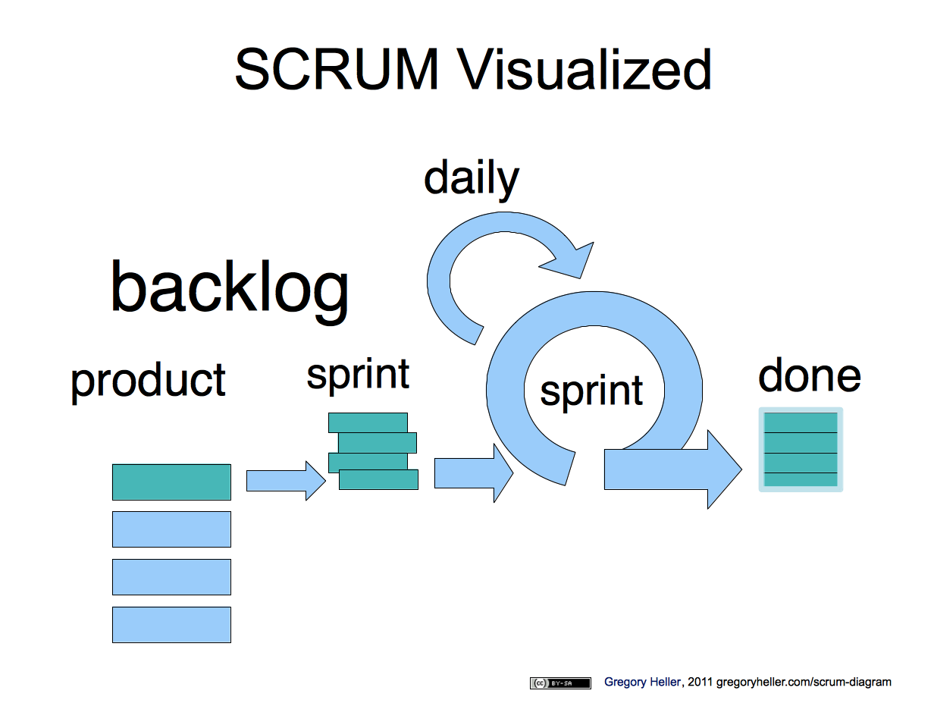
Team members leaving the project before it is complete​
sprint
backlog
product
backlog

Slide 9
SCRUM Advantages
Effective use of time and money
Project deliverables are completed quickly and efficiently
Team and individual work is visible throughout the project in meetings (Transparency)
Large projects are divided into more manageable sprints where development and test are done in each sprint
Adopts feedback from customers and stakeholders
Enables changes in between sprints during the project

Slide 10
SCRUM Disadvantages
High chances of project failure if individuals are not very committed
Huge negative impact on project if a team member leaves before the project is completed
Challenges adopting scrum in Large teams

Slide 11
Team members leaving the project before it is complete​
sprint
backlog
product
backlog

Slide 12
Why SCRUM over other frameworks?
Simple
Rules, objects, events and roles easy to understand
Complex tasks become manageable through user stories
Quick releases (sprints) keep the users happy and team motivated
Changes are welcome

Slide 13
References:
https://www.simplilearn.com/scrum-project-management-article

